Slide 1
Supercontinuum generation
Parameters
[1] Untapered region input
[2] Tapering
[3] Waist
[4] Uptapering region
[5] Untapered region output
The optimum design would have a look like this, allowing an easily integration with a connector.
Otherwise, to get the higher broadening, might be needed to cut throughout the fiber and test. This not only represents an unnecessary waste of time but also, the integration is not easy given the fiber is much smaller..
[2]
> 1 cm
[1]
[4]
[5]
[3]
Taper section = [2] + [3] + [4] < 20 cm
Region | Minimum value | Maximum value | Observations
1 | 1 cm | 3 cm | Too long would stretch the pulse more than desire
2 | 3 cm | 17 cm | Too sharp implies a higher level of losses. Also it might end up in reflection that could compromised the amplifier!
3 | 1 cm | 4 cm | Limitations lie in the scale. Needed for transitioning to higher diameters without significant losses.
4 | 1 cm | 4 cm | Same as 2, a too sharp might affect via reflections*
5 | 1 cm | - | The length of this region is actually irrelevant given all the broadening was already achieved in the previous sections

Slide 2
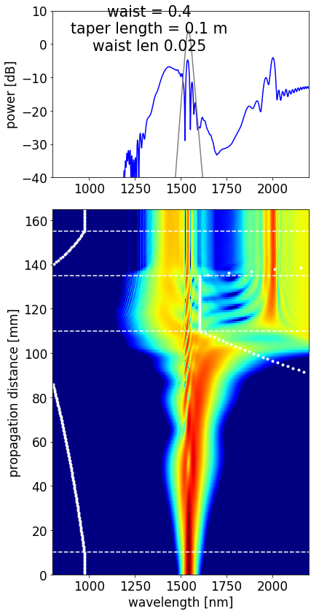
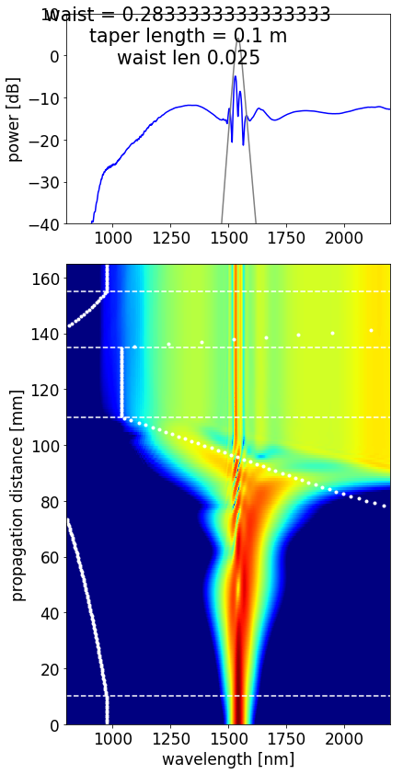
Criteria defined
High wavelength accessed
Low wavelength accessed
Waist scale defined by allowed transmission
Larger broadening with available setup and within fabrication limitations

Slide 3
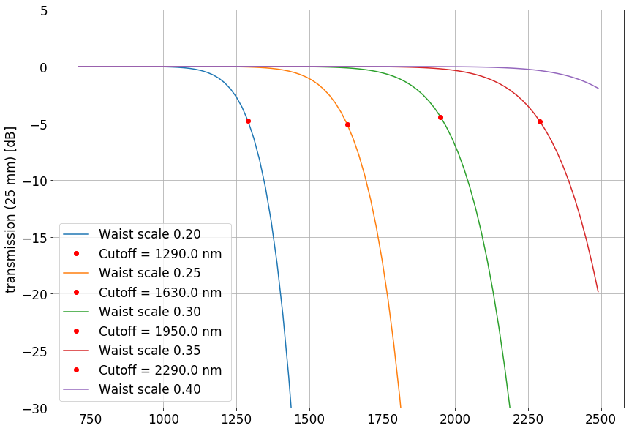
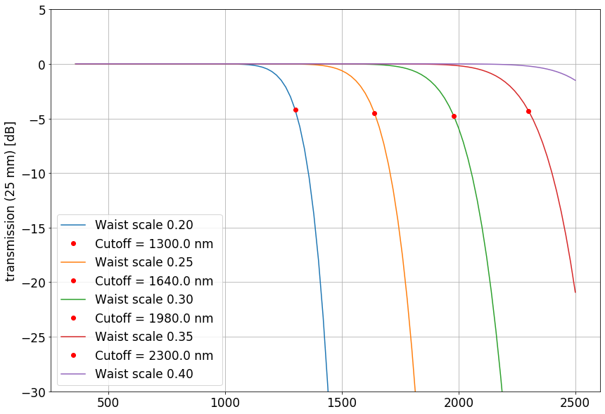
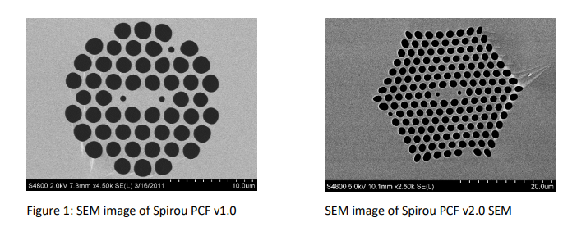
Ideal
Ideal
A limitation for the waist scale* seems clear when we see the wavelengths that are transmitted according to this value.
The best option would be a waist scale of 0.40 (50 µm). However, such large waist it is not optimum for broadening.
*Waist scale is a measure relative to the fiber diameter at the beginning (125 µm). Say, e.g., waist scale is 0.25 means the fiber diameter at the waist is 0.25 x 125 µm = 31.25 µm

Slide 4
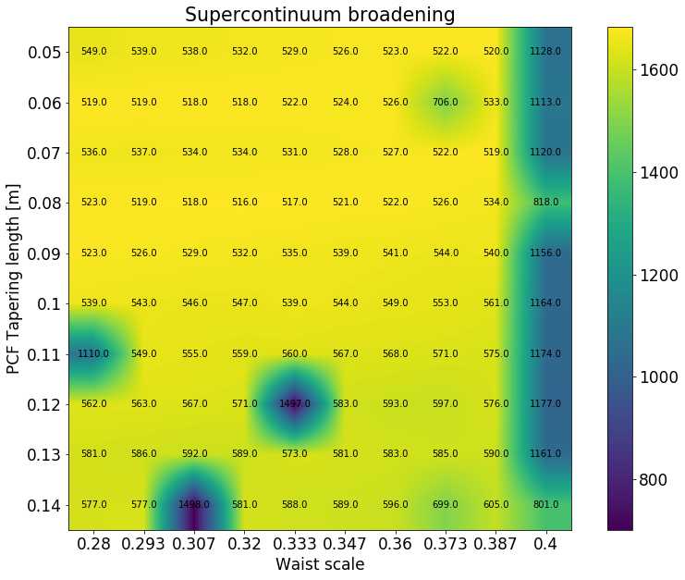
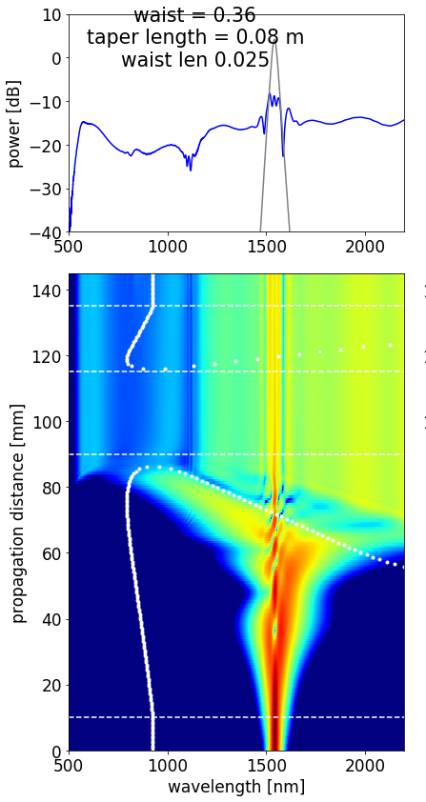
High power PCF version (8 W coupled, 110 fs pulse duration)
Colors = Broadening range
Numbers = Lower wavelength accessed
Higher wavelength is the same for all fibers given the transmission limitation

Slide 5
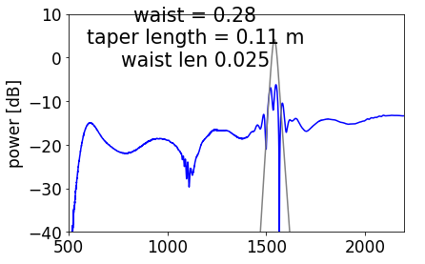
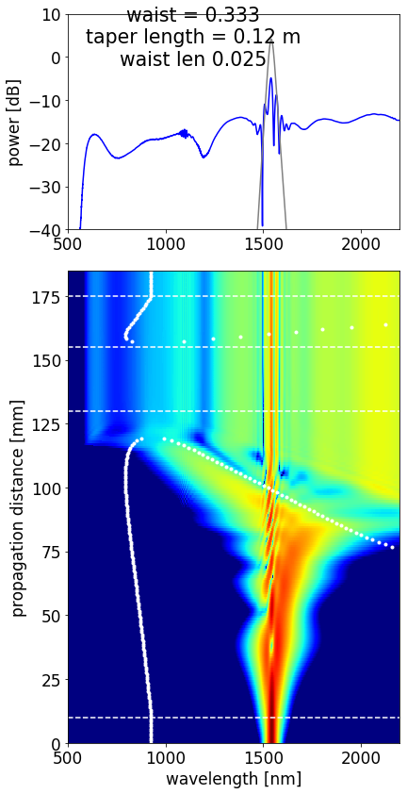
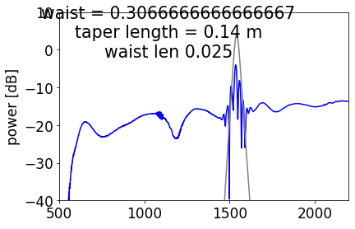
High power PCF version (8 W coupled, 110 fs pulse duration)
.
.

Slide 6
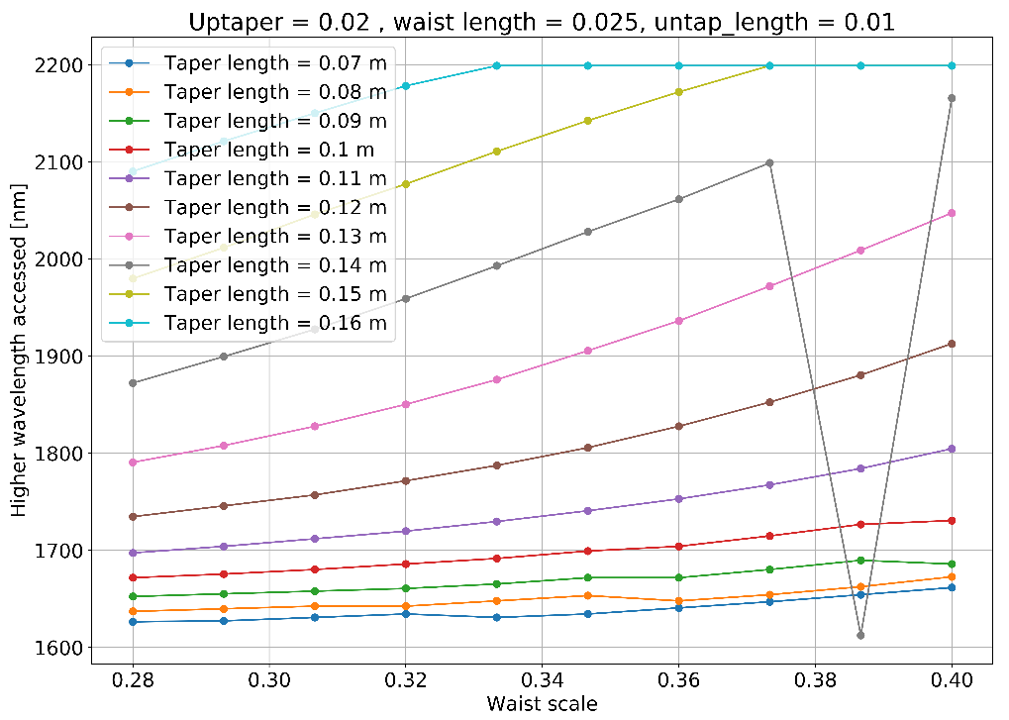
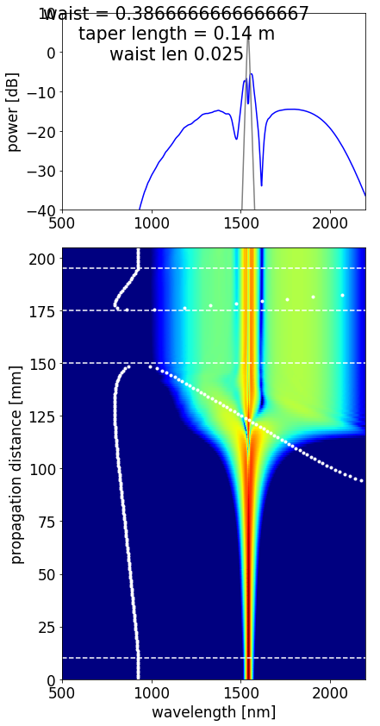
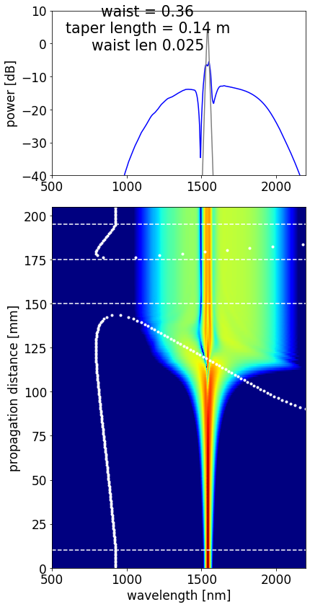
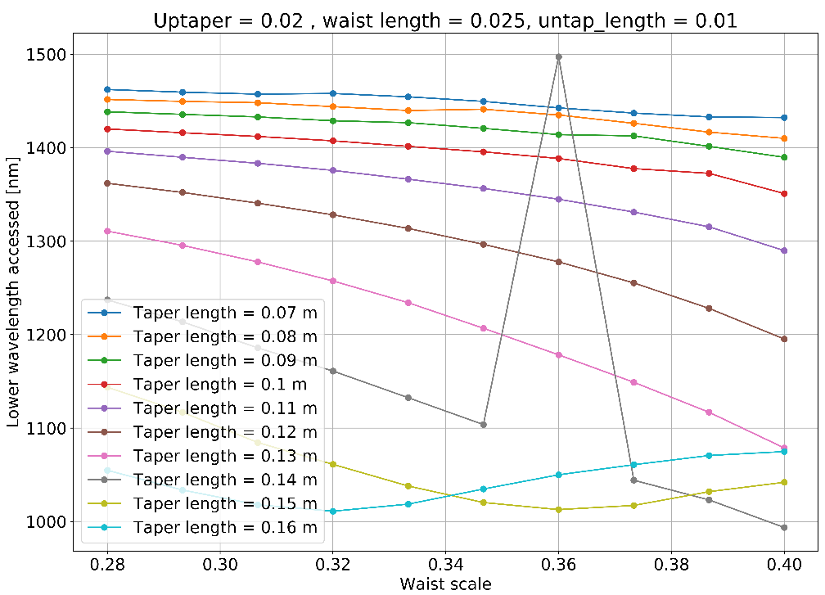
Low power PCF version (4 W coupled, 230 fs pulse duration)

Slide 7
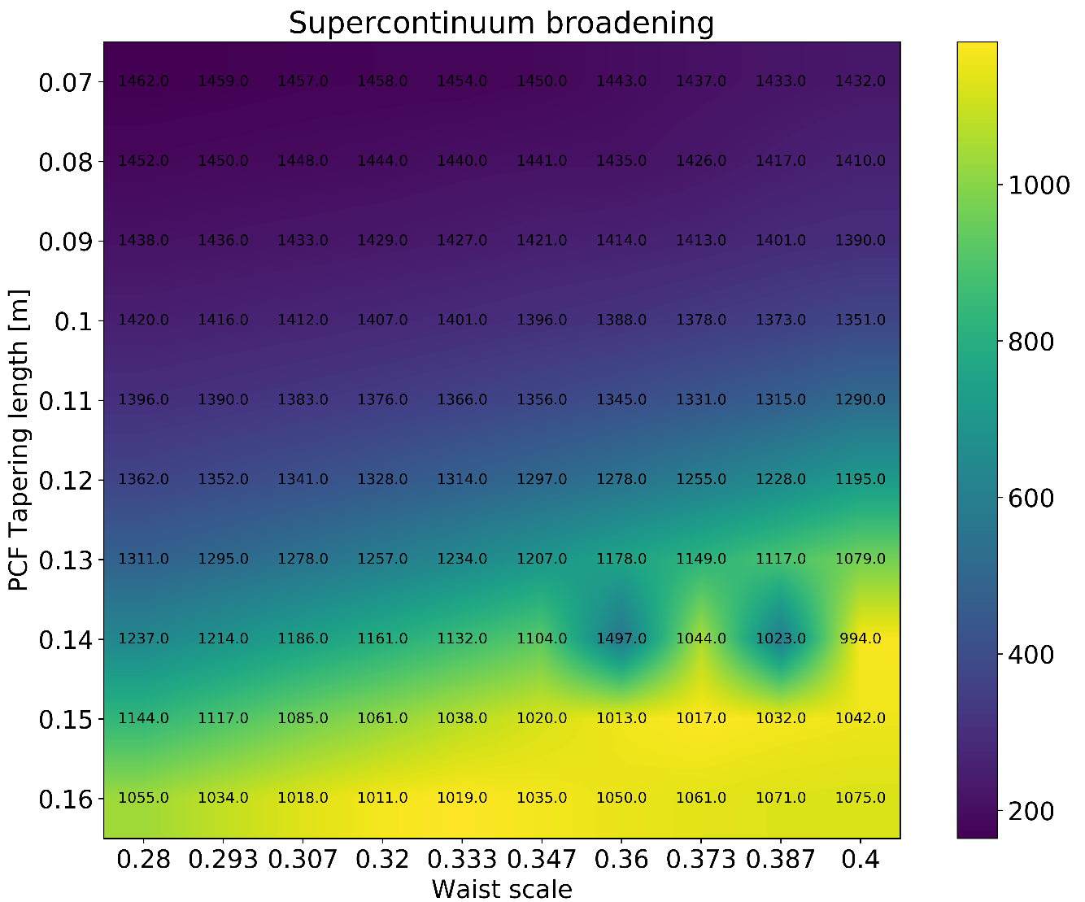
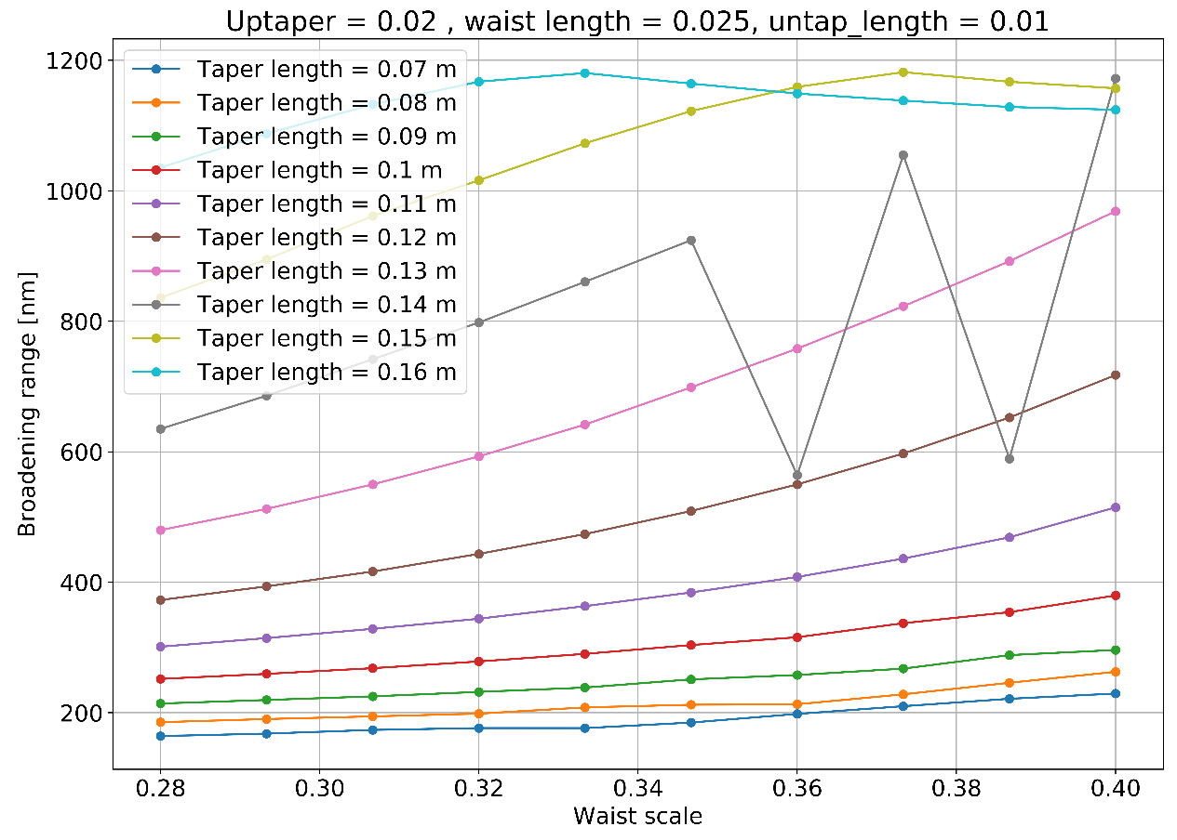
Low power PCF version (4 W coupled, 230 fs pulse duration)
Optimal for high power version

Slide 8
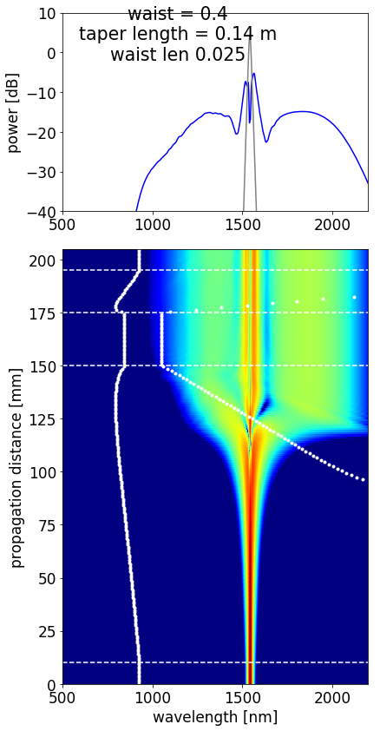
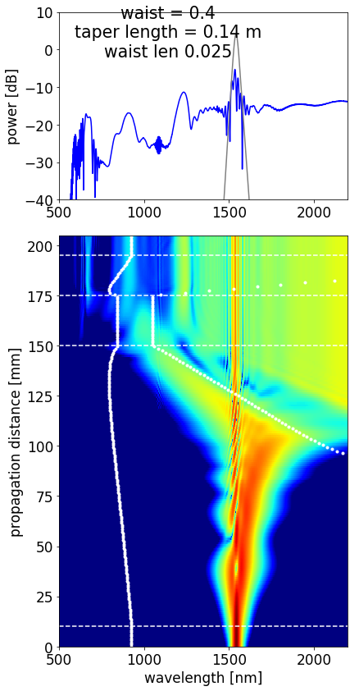
Low power PCF version (4 W coupled, 230 fs pulse duration)
4 W, 230 fs
Same with higher power and lower pulse duration
8 W, 110 fs

Slide 9
Summary
Parameter | High power version | Low power version | Fabrication limitations
PCF | Spirou v2 | Spirou v2 | -
Tapered length | 8 cm | 14 cm | 17 cm
Waist scale (core diameter) | 0.36 | 0.40 | > 0.1 (12.5 µm)
Waist length | 2.0 cm - 2.5 cm | 2.0 cm - 2.5 cm | > 1 cm
Up-tapered region | 2 cm | 2 cm | > 1 cm
Lower wavelength achievable | 522 nm | 994 nm (800 nm) | -
Higher wavelength achievable | 2300 nm | 2150 nm (2150 nm) | Depends on fiber and waist diameter
Spectral broadening range | ~1750 nm | ~1150 nm (1350 nm) | -
Coupled input power | 8 W | 4 W (8 W) | -
Pulse time duration | 110 fs | 230 fs (110 fs) | -
Total tapering section length | 12.5 cm | 18.5 cm | < 20 cm
 | Preference | Observations
Power requirement | Low power version | 5 W
Amplifier complexity | Low power version | No need for a chiller
Broadening achieved | High power version | 1750 nm of broadening

Slide 10
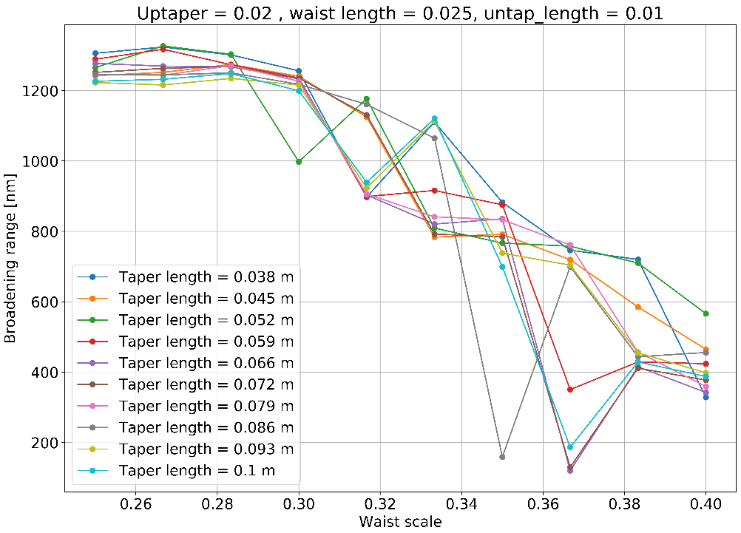
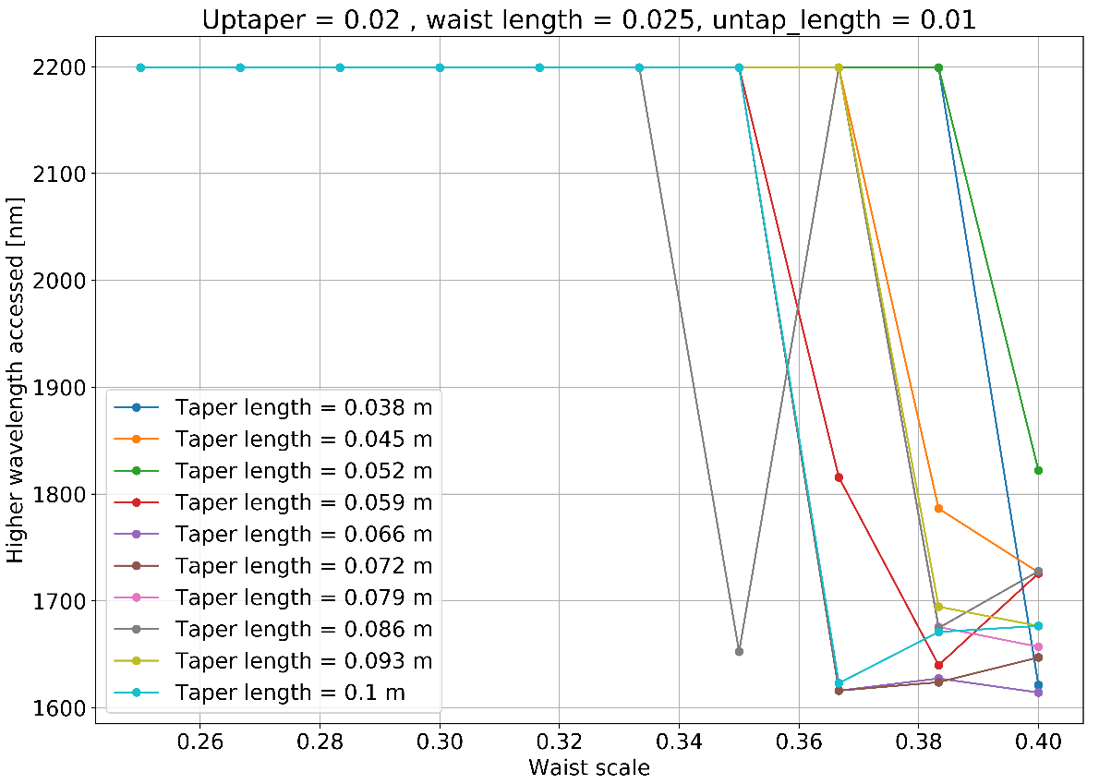
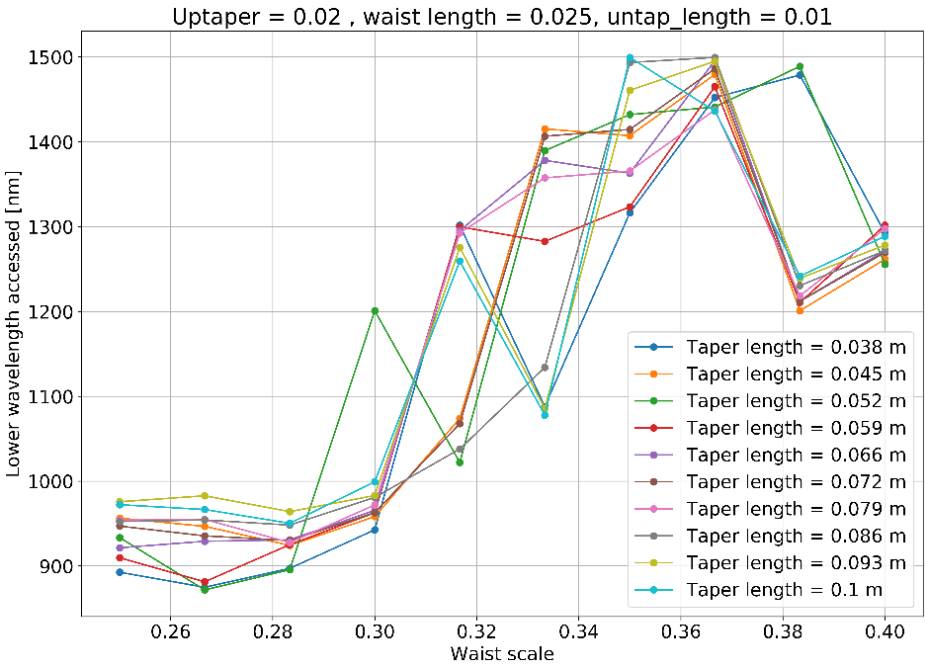
Waist scale variation with fixed waist length = 2.5 cm
Shorter fiber achieves lowest wavelengths
High wavelength depends exclusively on the transmission available by the waist.

